Slide 1
C Programming Basic Concepts

Slide 2
Tokens in C
Tokens in C is the most important element to be used in creating a program in C.
We can define the token as the smallest individual element in C.
For `example, we cannot create a sentence without using words; similarly, we cannot create a program in C without using tokens in C. Therefore, we can say that tokens in C is the building block or the basic component for creating a program in C language.

Slide 3
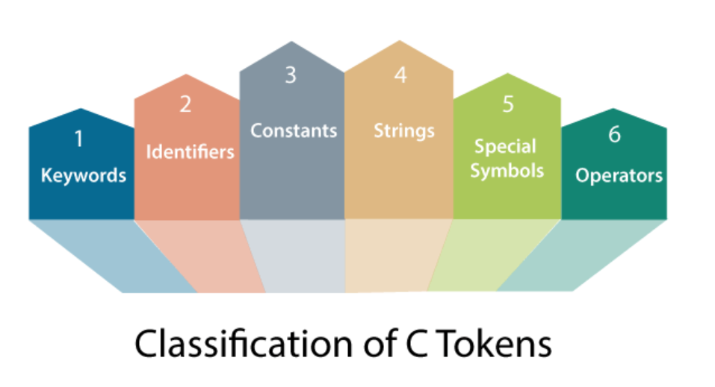

Slide 4
Keywords in C
can be defined as the pre-defined or the reserved words having its own importance, and each keyword has its own functionality. Since keywords are the pre-defined words used by the compiler, so they cannot be used as the variable names.
If the keywords are used as the variable names, it means that we are assigning a different meaning to the keyword, which is not allowed.
C language supports 32 keywords given below:

Slide 5
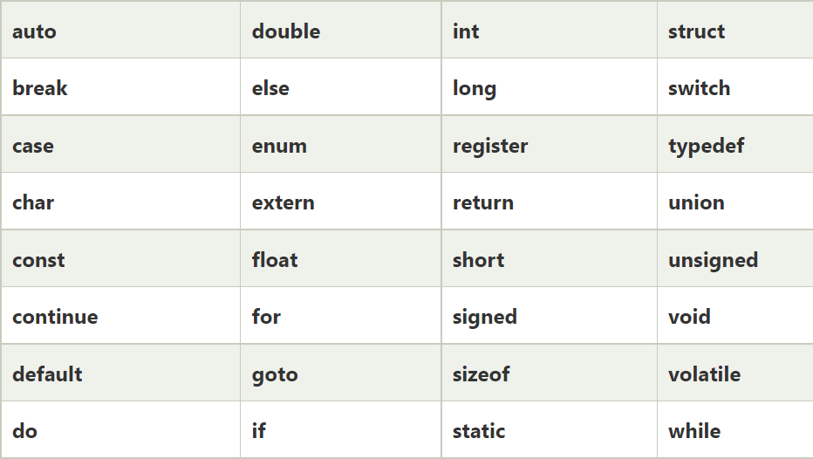

Slide 6
Identifiers in C :
are used for naming variables, functions, arrays, structures, etc. Identifiers in C are the user-defined words.
It can be composed of uppercase letters, lowercase letters, underscore, or digits, but the starting letter should be either an underscore or an alphabet.
Identifiers cannot be used as keywords.

Slide 7
Rules for constructing identifiers in C are given below:
The first character of an identifier should be either an alphabet or an underscore, and then it can be followed by any of the character, digit, or underscore.
It should not begin with any numerical digit.
In identifiers, both uppercase and lowercase letters are distinct. Therefore, we can say that identifiers are case sensitive.
Commas or blank spaces cannot be specified within an identifier.
Keywords cannot be represented as an identifier.
The length of the identifiers should not be more than 31 characters.
Identifiers should be written in such a way that it is meaningful, short, and easy to read.
Examples: int money;
double accountBalance;

Slide 8
Constants in C
C Constants is the most fundamental and essential part of the C programming language.
Constants in C are the fixed values that are used in a program, and its value remains the same during the entire execution of the program.
Constants are also called literals.
Constants can be any of the data types.
It is considered best practice to define constants using only upper-case names.
Syntax: const type constant _ name;

Slide 9
Example:
#include<stdio.h>
void main()
{
const int SIDE = 10;
int area;
area = SIDE*SIDE;
printf("The area of the square with side: %d is: %d sq. units" , SIDE, area);
}

Slide 10
Types of Constants
Numeric Constants
Integer Constants
Real Constants
Character Constants
Single Character Constants
String Constants
Backslash Character Constants

Slide 11
Integer Constants
It's referring to a sequence of digits.
Integers are of three types
Decimal Integer
Octal Integer
Hexadecimal Integer
Ex: 15, -265, 0, 99818, +25, 045, 0X6

Slide 12
Real Constants
The numbers containing fractional parts like 99.25 are called real or floating points constant.

Slide 13
Character Constants
Character Constants
  Single Character Constants
  String Constants
  Backslash Character Constants

Slide 14
  Single Character Constants
it simply contains a single character enclosed within ' and ' (a pair of single quote).
It is to be noted that the character '8' is not the same as 8. Character constants have a specific set of integer values known as ASCII values (American Standard Code for Information Interchange).
Example:
_{'X', '5', ';'}

Slide 15
String Constant
These are a sequence of characters enclosed in double quotes, and they may include letters, digits, special characters, and blank spaces.
It is again to be noted that "G" and 'G' are different - because "G" represents a string as it is enclosed within a pair of double quotes where as 'G' represents a single character.
Example:
"Hello!", "2015", "2+1"

Slide 16
C supports some character constants having a backslash in front of it.
The lists of backslash characters have a specific meaning which is known to the compiler.
They are also termed as "Escape Sequence".

Slide 17
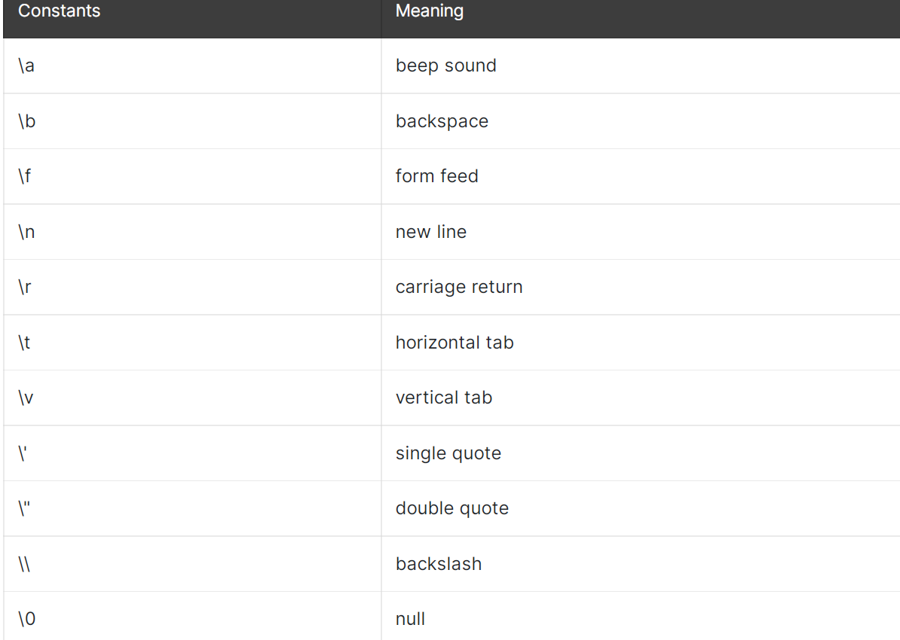
Example:

Slide 18
Strings:
String in C are always represented as an array of characters having null character '\0' at the end of the string.
This null character denotes the end of the string.
Strings in C are enclosed within double quotes, while characters are enclosed within single characters.
The size of a string is a number of characters that the string contains.
Now, we describe the strings in different ways:
Ex: char a[10] = "javatpoint"; // The compiler allocates the 10 bytes to the 'a' array.
char a[10] = {'j','a','v','a','t','p','o','i','n','t','\0'}; // String is represented in the form of characters.

Slide 19
Operator
Operator in c is a special symbol used to perform the functions. The data items on which the operators are applied are known as operands. Operators are applied between the operands.
Depending on the number of operands, operators are classified as follows:
Unary Operator
A unary operator is an operator applied to the single operand.
For example: increment operator (++), decrement operator (--), sizeof, (type)*.

Slide 20
Binary Operator
The binary operator is an operator applied between two operands. The following is the list of the binary operators:
Arithmetic Operators
Relational Operators
Shift Operators
Logical Operators
Bitwise Operators
Conditional Operators
Assignment Operator
Misc Operator

Slide 21
Special characters in C
Square brackets [ ]: The opening and closing brackets represent the single and multidimensional subscripts.
Simple brackets ( ): It is used in function declaration and function calling. For example, printf() is a pre-defined function.
Curly braces { }: It is used in the opening and closing of the code. It is used in the opening and closing of the loops.
Comma (,): It is used for separating for more than one statement and for example, separating function parameters in a function call, separating the variable when printing the value of more than one variable using a single printf statement.

Slide 23
Hash/pre-processor (#): It is used for pre-processor directive. It basically denotes that we are using the header file.
Asterisk (*): This symbol is used to represent pointers and also used as an operator for multiplication.
Tilde (~): It is used as a destructor to free memory.
Period (.): It is used to access a member of a structure or a union

Slide 24
Operator in c is a special symbol used to perform the functions. The data items on which the operators are applied are known as operands. Operators are applied between the operands.
Depending on the number of operands, operators are classified as follows:
Unary Operator
A unary operator is an operator applied to the single operand.
For example: increment operator (++)
decrement operator (--)
sizeof, (type)*.

Slide 25
Operator
Binary Operator
The binary operator is an operator applied between two operands. The following is the list of the binary operators:
Arithmetic Operators
Relational Operators
Shift Operators
Logical Operators
Bitwise Operators
Conditional Operators
Assignment Operator
Misc Operator

Slide 26
Operators are the special symbols in the C programming language, which is used to perform various mathematical and logical operations on the given operands to return the appropriate results.
There are various operators in the C programming language such as Arithmetic Operators, Relational Operators, Shift Operators, Logical Operators, Bitwise Operators, Ternary or Conditional Operators, and Assignment Operators.
But here, we will understand only the Arithmetic Operator in the C programming language.

Slide 27
C Arithmetic Operators
An arithmetic operator performs mathematical operations such as addition, subtraction, multiplication, division etc on numerical values (constants and variables).

Slide 28
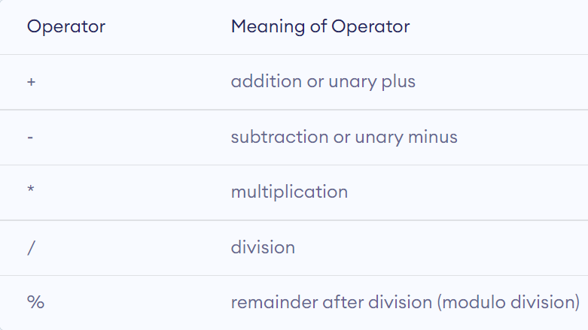

Slide 29
//Working of arithmetic operators
#include <stdio.h>
int main()
{
int a = 9,b = 4, c;
c = a+b;
printf("a+b = %d \n",c);
c = a-b;
printf("a-b = %d \n",c);
c = a*b;
printf("a*b = %d \n",c);
c = a/b;
printf("a/b = %d \n",c);
c = a%b;
printf("Remainder when a divided by b = %d \n", c);
return 0;
}

Slide 30
C Increment and Decrement Operators
C programming has two operators increment ++ and decrement -- to change the value of an operand (constant or variable) by 1.
Increment ++ increases the value by 1 whereas decrement -- decreases the value by 1. These two operators are unary operators, meaning they only operate on a single operand.
Two types Increment/Decrement Operator
Pre Increment/Pre Decrement.
Post Increment/Post decrement.

Slide 31
Pre-increment
Pre-increment operator: A pre-increment operator is used to increment the value of a variable before using it in a expression. In the Pre-Increment, value is first incremented and then used inside the expression.
Syntax:
a = ++x; Here, if the value of ‘x’ is 10 then value of ‘a’ will be 11 because the value of ‘x’ gets modified before using it in the expression.

Slide 32
Example:
#include <stdio.h>
#include <conio.h>
int main ()
{
int a = 7;
int b = 2
printf (" Use the pre-increment operator " );
printf (" The value of a is %d ", a);
printf (" The value of b is %d ", b);
b = ++a;
printf (" After using the pre-increment operator ");
printf (" The value of a is %d ", a);
printf (" The value of b is %d ", b);
return 0;
}

Slide 34
Example 2: Increment and Decrement Operators
#include <stdio.h>
int main()
{
int a = 10, b = 100; float c = 10.5, d = 100.5;
printf("++a = %d \n", ++a);
printf("--b = %d \n", --b);
printf("++c = %f \n", ++c);
printf("--d = %f \n", --d);
return 0;
}

Slide 35
Out-Put
++a = 11
--b = 99
++c = 11.500000
--d = 99.500000

Slide 36
There are different kinds of the operators, such as arithmetic, relational, bitwise, assignment, etc., in the C programming language.
The assignment operator is used to assign the value, variable and function to another variable.
Let's discuss the various types of the assignment operators such as =, +=, -=, /=, *= and %=.

Slide 37
Relational Operator in C
Operators are the special symbols used to perform mathematical and logical operations to the given operands.
There are various types of operators in C, such as arithmetic, logical, bitwise, relational, conditional or ternary, etc.
Relational Operators are the operators used to create a relationship and compare the values of two operands.
For example, there are two numbers, 5 and 15, and we can get the greatest number using the greater than operator (>) that returns 15 as the greatest or larger number to the 5.

Slide 38
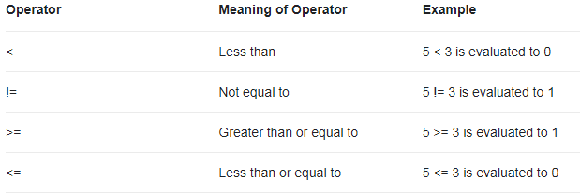

Slide 39
Types of Relational Operators
Equal To Operator (==)
It is used to compare both operands and returns 1 if both are equal or the same, and 0 represents the operands that are not equal.
Syntax:
Opr1 == Opr2

Slide 40
Example:
#include <stdio.h>
#include <math.h>
int main ()
{
int a = 5;
int b = 10;
// Use Equal To Operator
printf (" a == b : %d", (a == b));
if (a == b)
printf ("\n %d is equal to %d", a, b);
else
printf (" \n %d is not equal to %d", a, b);
int x = 5;
int y = 5;
// Use Equal To Operator
printf (" \n x == y : %d", (x == y));
if (a == b)
printf (" \n %d is equal to %d", x, y);
else
printf ("\n %d is not equal to %d", x, y);
return 0;
}

Slide 41
OutPut:
a == b : 0 5 is not equal to 10
x == y : 1 5 is not equal to 5

Slide 42
Example on Relational Operator
#include <stdio.h>
int main()
{
int a = 5, b = 5, c = 10;
printf("%d == %d is %d \n", a, b, a == b);
printf("%d == %d is %d \n", a, c, a == c);
printf("%d > %d is %d \n", a, b, a > b);
printf("%d > %d is %d \n", a, c, a > c);
printf("%d < %d is %d \n", a, b, a < b);
printf("%d < %d is %d \n", a, c, a < c);
printf("%d != %d is %d \n", a, b, a != b);
printf("%d != %d is %d \n", a, c, a != c);
printf("%d >= %d is %d \n", a, b, a >= b);
printf("%d >= %d is %d \n", a, c, a >= c);
printf("%d <= %d is %d \n", a, b, a <= b);
printf("%d <= %d is %d \n", a, c, a <= c);
return 0;
}

Slide 43
Out-Put
5 == 5 is 1
5 == 10 is 0
5 > 5 is 0
5 > 10 is 0
5 < 5 is 0
5 < 10 is 1
5 != 5 is 0
5 != 10 is 1
5 >= 5 is 1
5 >= 10 is 0
5 <= 5 is 1
5 <= 10 is 1

Slide 44
Not Equal To Operator (!=)
The Not Equal To Operator is the opposite of the Equal To Operator and is represented as the (!=) operator.
The Not Equal To Operator compares two operands and returns 1 if both operands are not the same; otherwise, it returns 0.
Syntax:
Opr1 != Opr2;

Slide 45
Less than Operator (<)
It is used to check whether the value of the left operand is less than the right operand, and if the statement is true, the operator is known as the Less than Operator.
Syntax:
A < B;

Slide 46
Example:
#include <stdio.h>
int main ()
{
int num1, num2;
printf (" Enter the value of num1: ");
scanf (" %d", &num1);
printf (" \n Enter the value of num2: ");
scanf (" %d", &num2);
// use less than operator (<)
if (num1 < num2)
{
printf (" \n The value of num1 is less than num2.");
}
else
{
printf (" \n The value of num2 is less than num1.");
}
return 0;
}

Slide 47
Enter the value of num1: 45
Enter the value of num2: 89
The value of num1 is less than num2.

Slide 48
Greater than Operator (>)
The operator checks the value of the left operand is greater than the right operand, and if the statement is true, the operator is said to be the Greater Than Operator.
Syntax:
A > B;

Slide 49
#include <stdio.h> Examples
int main ()
{
int num1, num2;
printf (" Enter the value of num1: ");
scanf (" %d", &num1);
printf (" \n Enter the value of num2: ");
scanf (" %d", &num2);
// use greater than operator (>)
if (num1 > num2)
{
printf (" \n The value of num1 is greater than num2.");
}
else
{
printf (" \n The value of num2 is greater than num1.");
}
return 0;
}

Slide 50
Less than Equal To Operator (<=)
The operator checks whether the value of the left operand is less than or equal to the right operand, and if the statement is true, the operator is said to be the Less than Equal To Operator.
Syntax:
A <= B;
Here, operand A is less than or equal to operand B. So, it is a Less than Equal to Operator.
Let's create a program to use the Less than Equal to operator (<=) to compare the operand value in C

Slide 51
Example:
#include <stdio.h>
int main ()
{
int num1, num2;
printf (" Enter the value of num1: ");
scanf (" %d", &num1);
printf (" \n Enter the value of num2: ");
scanf (" %d", &num2);
if (num1 > num2)
{
printf (" \n The value of num1 is greater than num2.");
}
else if (num1 >= num2 ) // greater than operator (>=)
{
printf (" \n The value of num1 is equal to num2.");
}
else
{
printf (" \n The value of num2 is greater than num1.");
}
return 0;
}

Slide 52
Greater than Equal To Operator (>=)
The operator checks whether the left operand's value is greater than or equal to the right operand.
If the statement is true, the operator is said to be the Greater than Equal to Operator.
Syntax:
A >= B;
Here, operand A is greater than equal to the right operand B. So, it is the Greater than Equal To operator.
Let's create a program to use the Greater than Equal To operator to compare the operand value in C.

Slide 53
Example:
#include <stdio.h>
int main ()
{
int num1, num2;
printf (" Enter the value of num1: ");
scanf (" %d", &num1);
printf (" \n Enter the value of num2: ");
scanf (" %d", &num2);
if (num1 > num2)
{
printf (" \n The value of num1 is greater than num2.");
}
else if (num1 >= num2 ) // greater than operator (>=)
{
printf (" \n The value of num1 is equal to num2.");
}
else
{
printf (" \n The value of num2 is greater than num1.");
}
return 0;
}

Slide 54
Shift Operators in C
This section will discuss the Bitwise shift operators in the c programming language. Bitwise shift operator is used to shift the binary bits either in the left direction right direction according to the program's requirement.
Shift operators are classified into two types based on the shifting position of the bits.
Left Shift Operator
Right Shift Operator

Slide 55
Left Shift Operator
The left shift operator is a type of Bitwise shift operator, which performs operations on the binary bits.
It is a binary operator that requires two operands to shift or move the position of the bits to the left side and add zeroes to the empty space created at the right side after shifting the bits.
Syntax:
var_name << no_of_position
*In the above syntax, var_name represents the integer variable name on which the left shift (<<) operation is to be performed to shift the binary bits at the left side. And the no_of_position variable represents the number of bits to be placed or shifted at the left side.
* In other words, the left shift operator shifts the binary bits of the first operand on the left side by the defined number of bits to the second operand.

Slide 56
Example:
#include <stdio.h>
int main ()
{
int num;
printf (" Enter a positive number: ");
scanf (" %d", &num);
num = (num << 2); // It shifts two bits at the left side
printf (" \n After shifting the binary bits to the left side. ");
printf (" \n The new value of the variable num = %d", num);
return 0;
}
Out-Put:
Enter a positive number: 25
After shifting the binary bits to the left side.
The new value of the variable num = 100

Slide 57
Right shift operator
The right shift operator is a type of bitwise shift operator used to move the bits at the right side, and it is represented as the double (>>) arrow symbol.
Like the Left shift operator, the Right shift operator also requires two operands to shift the bits at the right side and then insert the zeroes at the empty space created at the left side after shifting the bits.
Syntax:
var_name >> no_of_position
* In the above syntax, var_name represents the integer variable on which the right shift (>>) operation is to be performed to shift the binary bits at the right side. And the no_of_position variable represents the number of bits to be placed or shifted to the right side.
In other words, the right shift operator shifts the binary bits of the first operand at the right side by defining the total number of bits to the second operand.*

Slide 58
Example:
#include <stdio.h>
int main ()
{
// declare local variable
int num;
printf (" Enter a positive number: ");
scanf (" %d", &num);
// use right shift operator to shift the bits
num = (num >> 2); // It shifts two bits at the right side
printf (" \n After shifting the binary bits to the right side. ");
printf (" \n The new value of the variable num = %d", num);
return 0;
}

Slide 59
Out _ put:
Enter a positive number: 25
After shifting the binary bits to the right side.
The new value of the variable num = 6

Slide 60
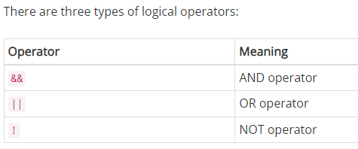
Logical Operator
Logical operators are used to evaluate two or more conditions. In General, Logical operators are used to combine relational expressions, but they are not limited to just relational expression you can use any kind of expression even constants.
If the result of the logical operator is true then 1 is returned otherwise 0 is returned.

Slide 61
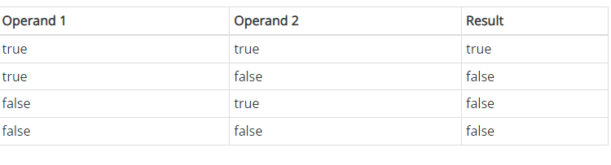
The AND ( && ) and OR ( || ) are binary operator while NOT ( ! ) is a unary operator.
Before we start explaining && operator, keep in mind that - In C, all non-zero values are considered as true ( 1 ) while 0 is considered as false.
AND (&&) operator :
This operator gives the net result of true (i.e 1) if both operands are true, otherwise false (i.e 0).
True Table:

Slide 62
Example:
int a = 12, b = 3;
Suppose we have the following logical expression:
(a==12) && (b<5)
In the above expression both the conditions (a == 12 and b < 5) are true, therefore the whole expression is true. As a result, the value of the whole logical expression is 1.

Slide 63
Example:
#include<stdio.h>
int main()
{
int a = 12, result;
printf("Initial value of a = %d\n", a);
result = (a==11) && (a++);
printf("Final value of a = %d\n", a);
printf("Result of logical expression = %d\n", result);
return 0;
}

Slide 64
Logical Operators in C
Logical operators are part of binary operators. These operators are specifically used when we are going to combine two or more requirements together.
These can be used in many conditional and relational expressions.
On evaluating these conditions, these are the Boolean expressions which give an output of either 1/0 for True/False respectively.

Slide 65
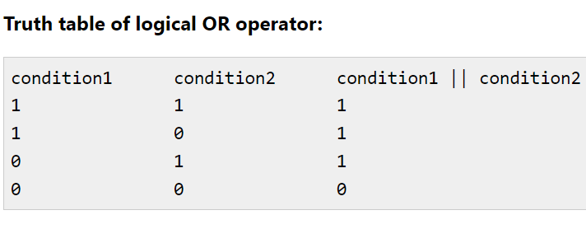

Slide 66
C examples of Logical OR (||) operator
#include <stdio.h>
int main()
{
int num =10; //printing result with OR (||) operator
printf("%d\n",(num==10 || num>=5));
printf("%d\n",(num>=5 || num<=50));
printf("%d\n",(num!=10 || num>=5));
printf("%d\n",(num>=20 || num!=10));
return 0;
}

Slide 67
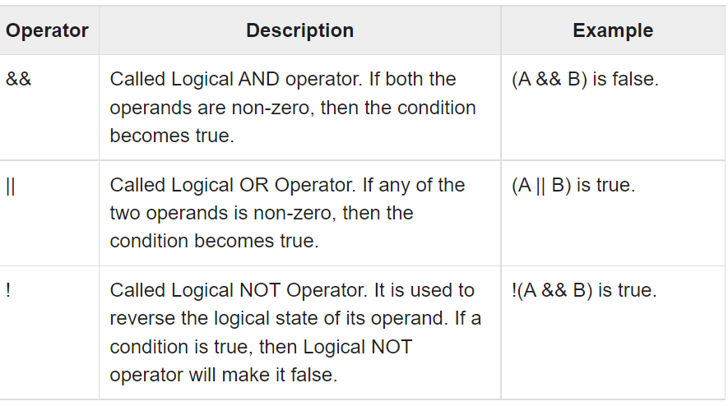
Meaning Description of Relational Operator

Slide 68
variable
A variable is a name of the memory location. It is used to store data. Its value can be changed, and it can be reused many times.
It is a way to represent memory location through symbol so that it can be easily identified.
Let's see the syntax to declare a variable:
type variable _ list;
Syntax
Datatype variable_name;
int a;

Slide 69
To Declare any variable in C language you need to follow rules and regulation of C Language
Every variable name should start with alphabets or underscore (_).
No spaces are allowed in variable declaration.
Except underscore (_) no other special symbol are allowed in the middle of the variable declaration (not allowed -> roll-no, allowed -> roll_no).
Maximum length of variable is 8 characters depend on compiler and operation system.
Every variable name always should exist in the left hand side of assignment operator (invalid -> 10=a; valid -> a=10;).
No keyword should access variable name (int for <- invalid because for is keyword).

Slide 70
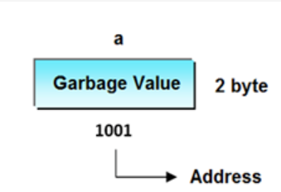
Garbage value
Garbage value can be any value given by system and that is no way related to correct programs. This is a disadvantage of C programming language and in C programming it can overcome using variable initialization.

Slide 71
If no input values are assigned by the user than system will gives a default value called garbage value.

Slide 72
Types of Variables in C
Local variable
global variable
static variable
automatic variable
external variable

Slide 73
Local Variable
A variable that is declared inside the function or block is called a local variable.
void function1()
{
int x=10; //local variable
}

Slide 74
Example:
int area()
{
int length=10; //local variable
int breadth = 5; //local variable
int rectarea = length*breadth; //local variable
return rectarea;
}

Slide 75
Global Variable
A variable that is declared outside the function or block is called a global variable. Any function can change the value of the global variable. It is available to all the functions.
int value=20; //global variable
void function1()
{
int x=10; //local variable
}

Slide 76
Example:
#include <stdio.h>;
int sum = 10; /* declaring and initializing a Global variable */
int main()
{
{
int sum = 100; /* Declaring and initializing a Local variable with the same name */
printf(" SUM = %dn", sum);
}
return 0;
}

Slide 77
Static Variable
Static variables are initialized only once. The compiler persists with the variable till the end of the program.
Static variables can be defined inside or outside the function.
They are local to the block.
The default value of static variables is zero.
The static variables are alive till the execution of the program.

Slide 78
Syntax: static datatype variable_name = value;
Here,
datatype − The datatype of variable like int, char, float etc.
variable_name − This is the name of variable given by user.
value − Any value to initialize the variable. By default, it is zero.

Slide 79
Multiple variables can be initialized in a single statement by single value
a=b=c=d=e=10;
*C program to demonstrate Declaration and initialization*
#include void main()
{
int a, b, c, d, e; // Declaration of variable a=b=c=d=e=10; // initialization of variable
printf("%d \n",a);
printf("%d \n",b);
printf("%d \n",c);
printf("%d \n",d);
printf("%d \n",e);
}

Slide 80
:Define Data Type:
A data-type in C programming is a set of values and is determined to act on those values. C provides various types of data-types which allow the programmer to select the appropriate type for the variable to set its value.
A data type specifies the type of data that a variable can store such as integer, floating, character, etc.

Slide 81
C Data Types are used to:
Identify the type of a variable when it declared.
Identify the type of the return value of a function.
Identify the type of a parameter expected by a function.

Slide 82
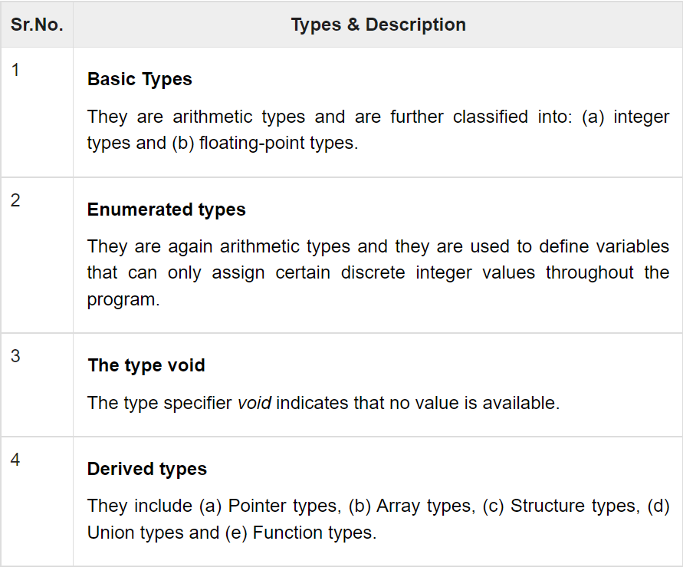

Slide 83
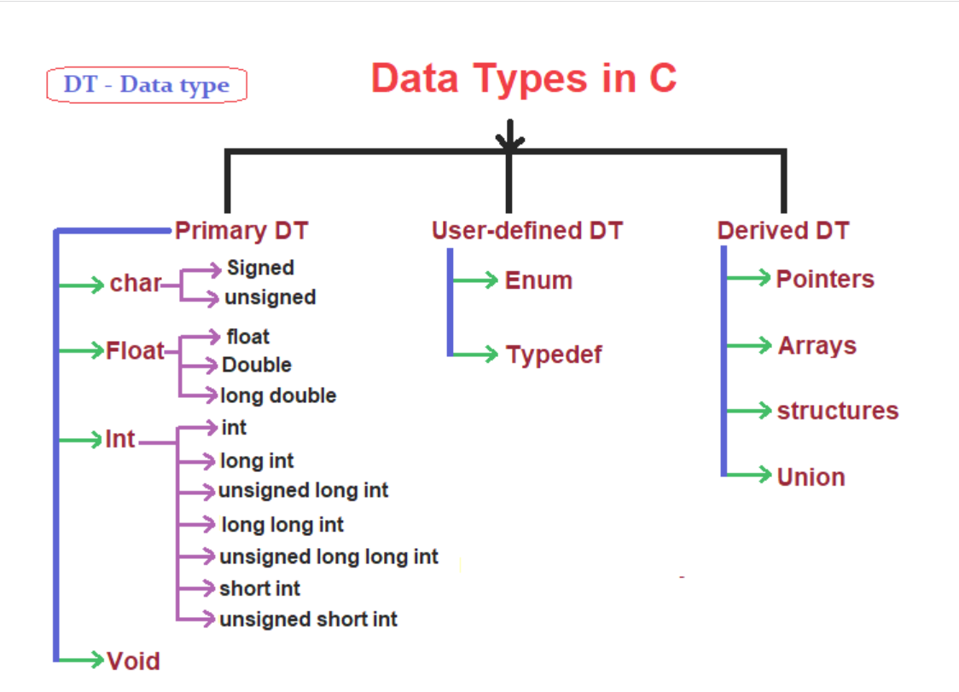

Slide 84
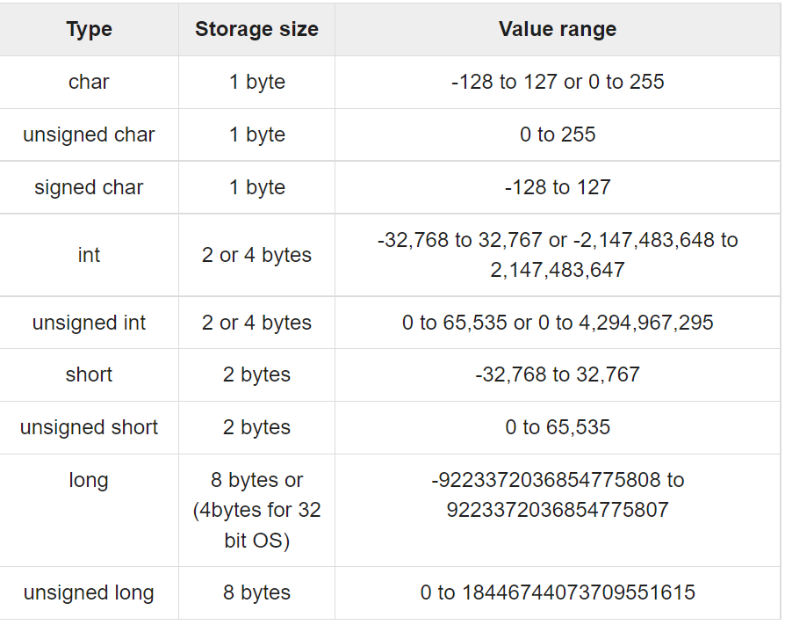
Data Type size, Storage and range

Slide 85
Integer Data_Type
Integer data type allows a variable to store numeric values.
“int” keyword is used to refer integer data type.
The storage size of int data type is 2 or 4 or 8 byte.
It varies depend upon the processor in the CPU that we use. If we are using 16 bit processor, 2 byte (16 bit) of memory will be allocated for int data type.
Like wise, 4 byte (32 bit) of memory for 32 bit processor and 8 byte (64 bit) of memory for 64 bit processor is allocated for int datatype.
int (2 byte) can store values from -32,768 to +32,767
int (4 byte) can store values from -2,147,483,648 to +2,147,483,647.
If you want to use the integer value that crosses the above limit, you can go for “long int” and “long long int” for which the limits are very high.

Slide 86
Float Data type:
In C, float data type occupies 4 bytes (32 bits) of memory to store real numbers that have at least one digit after the decimal point. A float data type can hold any value between 3.4E-38 to 3.4E+38.
The floating-point variable has a precision of 6 digits i.e., it uses 6 digits after the decimal point. Consider the following example that uses a float data type:

Slide 87
Floating point data type consists of 2 types. They are,
float
double
1. FLOAT:
Float data type allows a variable to store decimal values.
Storage size of float data type is 4. This also varies depend upon the processor in the CPU as “int” data type.
We can use up-to 6 digits after decimal using float data type.
For example, 10.456789 can be stored in a variable using float data type.
2. DOUBLE:
Double data type is also same as float data type which allows up-to 10 digits after decimal.
The range for double datatype is from 1E–37 to 1E+37.

Slide 88
Char Data-Type
Character data type allows a variable to store only one character.
Storage size of character data type is 1. We can store only one character using character data type.
“char” keyword is used to refer character data type.
For example, ‘A’ can be stored using char data type. You can’t store more than one character using char data type.
Please refer C – Strings topic to know how to store more than one characters in a variable.
Syntax: data type variable name=‘value’
Ex: char test = 'h';

Slide 89
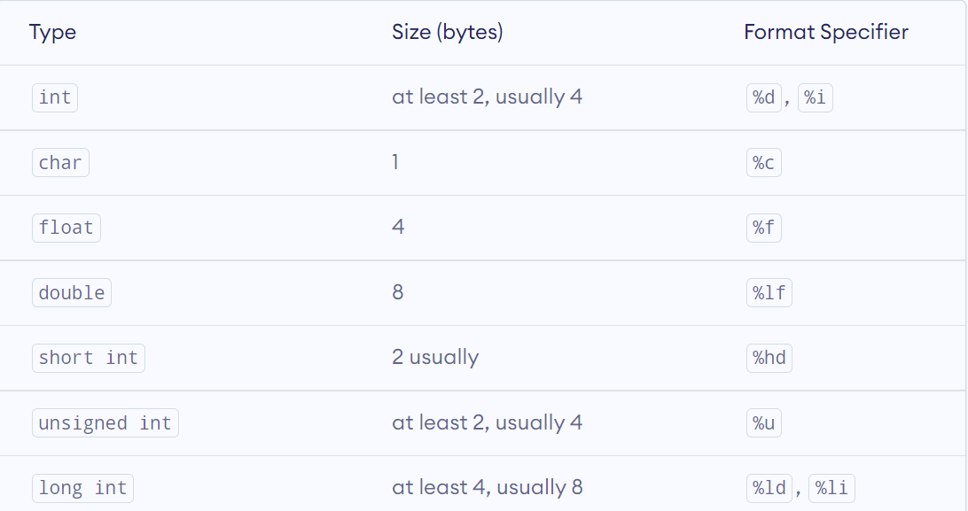
Data Types with Specifier

Slide 90
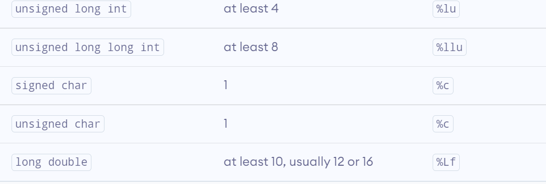

Slide 91
Formatted input/output functions
Formatted console input/output functions are used to take one or more inputs from the user at console and it also allows us to display one or multiple values in the output to the user at the console.
While calling any of the formatted console input/output functions, we must use a specific format specifiers in them, which allow us to read or display any value of a specific primitive data type.

Slide 92
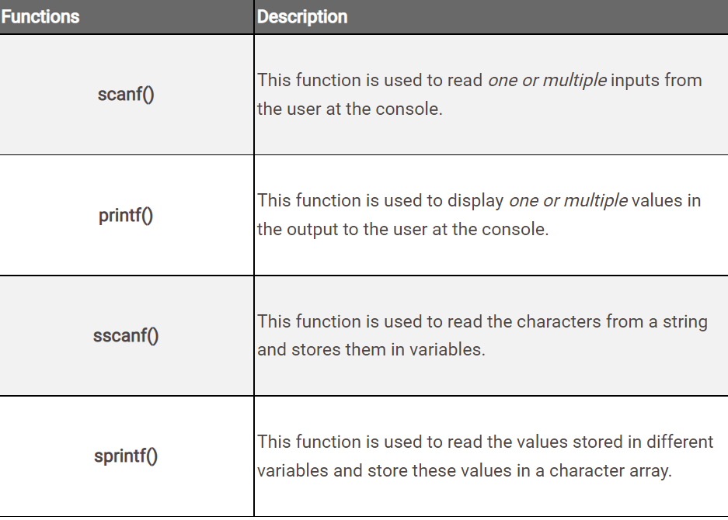
Some of the most important formatted console input/output functions are -

Slide 93
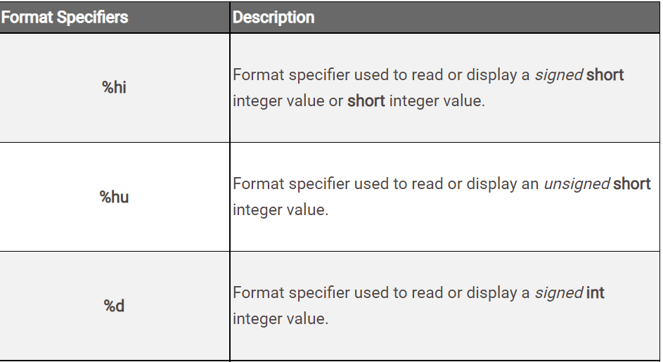
Let's see what are these format specifiers.

Slide 94
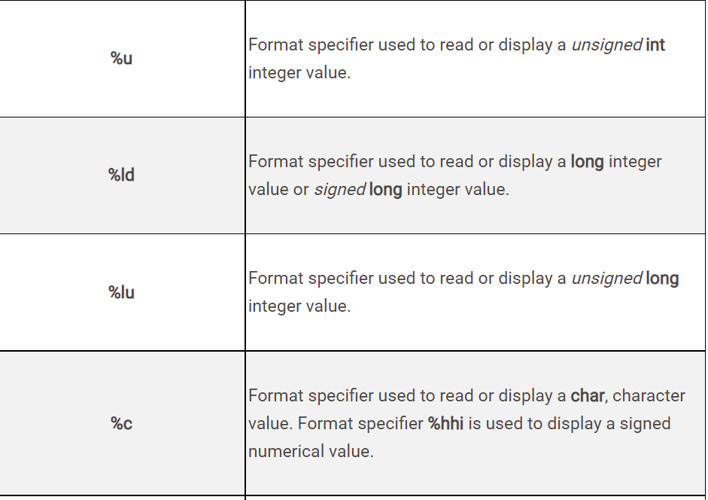

Slide 95
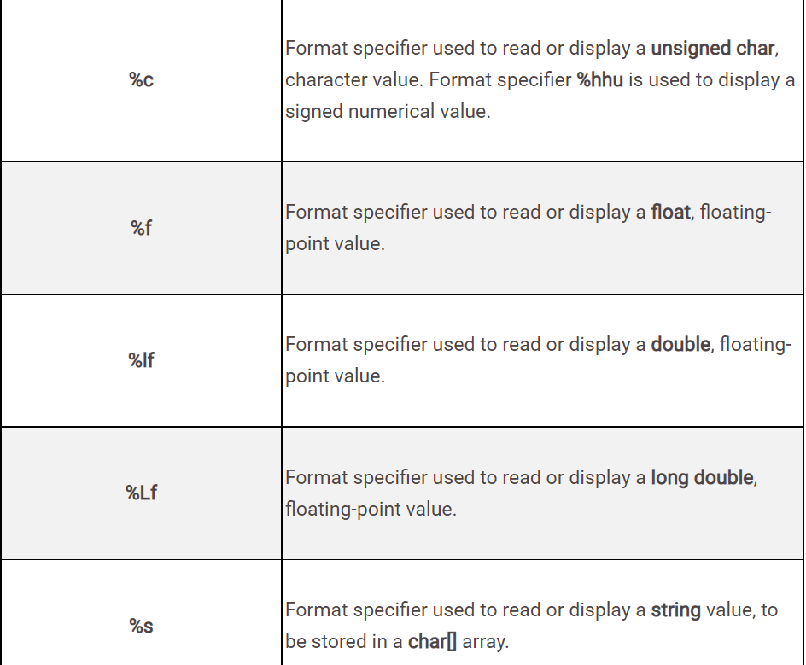

Slide 96
Unformatted input / Output functions
Unformatted input and output functions read a single input sent by the user and permits to display the value as the output at the console.

Slide 97
Difference between Formatted and Unformatted Functions
Formatted I/O functions allow to supply input or display output in user desired format.
Unformatted I/O functions are the most basic form of input and output and they do not allow to supply input or display output in user desired format.
printf() and scanf() are examples for formatted input and output functions.
getch(), getche(), getchar(), gets(), puts(), putchar() etc. are examples of unformatted input output functions.

Slide 98
Formatted input and output functions contain format specifier in their syntax.
Unformatted input and output functions do not contain format specifier in their syntax.
Formatted I/O functions are used for storing data more user friendly.
Unformatted I/O functions are used for storing data more compactly.

Slide 99
Formatted I/O functions are used with all data types.
Unformatted I/O functions are used mainly for character and string data types.

Slide 100
Formatted I/O Example:
#include<stdio.h>
#include<conio.h>
void main()
{
int a;
clrscr();
printf(“Enter value of a:”);
scanf(“%d”, &a);
printf(“ a = %d”, a);
getch();
}

Slide 101
Unformatted I/O Example:
#include<stdio.h>
#include<conio.h>
void main()
{
char ch ;
clrscr();
printf(“Press any character:”);
ch = getche();
printf(“\nYou pressed :” putchar(ch));
getch();
}

Slide 103
Output of the above program is:
Press any character: L
You pressed: L

Slide 104
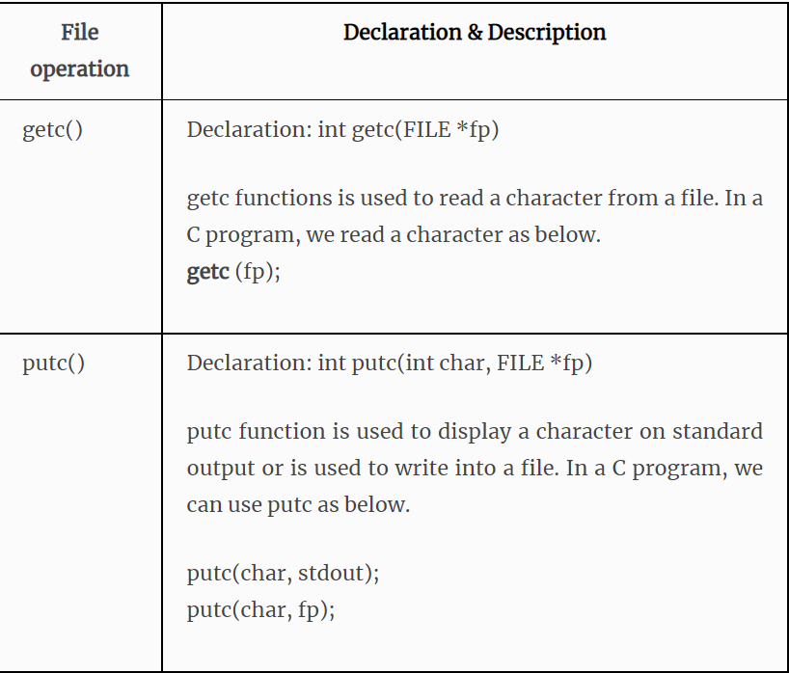

Slide 105
C gets() and puts() functions
The gets() and puts() are declared in the header file stdio.h. Both the functions are involved in the input/output operations of the strings.
C gets() function
The gets() function enables the user to enter some characters followed by the enter key.
All the characters entered by the user get stored in a character array.
The null character is added to the array to make it a string.
The gets() allows the user to enter the space-separated strings.
It returns the string entered by the user.

Slide 106
Declaration
Syntax: char[] gets(char[]);
Reading string using gets()
#include<stdio.h>
void main ()
{
char s[30];
printf("Enter the string? ");
gets(s);
printf("You entered %s",s);
}

Slide 107
C puts() function
The puts() function is very much similar to print f() function.
The puts() function is used to print the string on the console which is previously read by using gets() or scan f() function.
The puts() function returns an integer value representing the number of characters being printed on the console. Since, it prints an additional newline character with the string, which moves the cursor to the new line on the console, the integer value returned by puts() will always be equal to the number of characters present in the string plus 1.

Slide 108
Declaration
Syntax: int puts(char[])
Let's see an example to read a string using gets() and print it on the console using puts().
#include<stdio.h>
#include <string.h>
int main()
{
char name[50];
printf("Enter your name: ");
gets(name); //reads string from user
printf("Your name is: ");
puts(name); //displays string
return 0;
}

Slide 109
Output:
Enter your name: hi its pooja
Your name is: hi its poojs

Slide 110
Example:
#include<stdio.h>
#include <string.h>
int main()
{
char name[50];
printf("Enter your name: ");
gets(name); //reads string from user
printf("Your name is: ");
puts(name); //displays string
return 0;
}

Slide 111
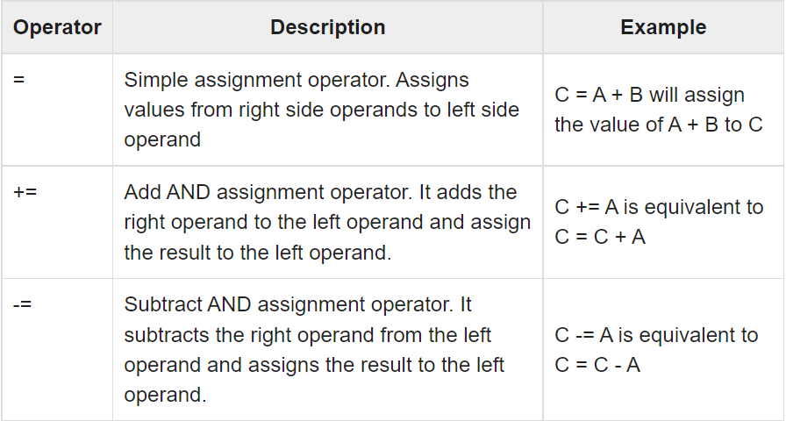

Slide 112
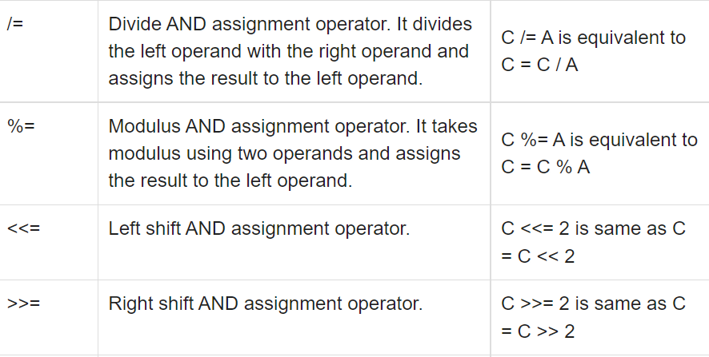

Slide 113
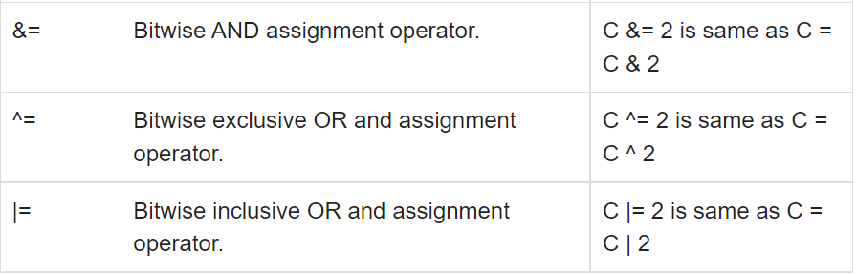

Slide 114
Operator Precedence and Associativity in C
Operator precedence: It dictates the order of evaluation of operators in an expression.
Associativity: It defines the order in which operators of the same precedence are evaluated in an expression. Associativity can be either from left to right or right to left.
Operator precedence determines the grouping of terms in an
expression and decides how an expression is evaluated.
Certain operators have higher precedence than others; for example, the multiplication operator has a higher precedence than the addition operator.
For example: x = 7 + 3 * 2; here, x is assigned 13, operator * has a higher precedence than +, so it first gets multiplied with 3*2 and then adds into 7.

Slide 115
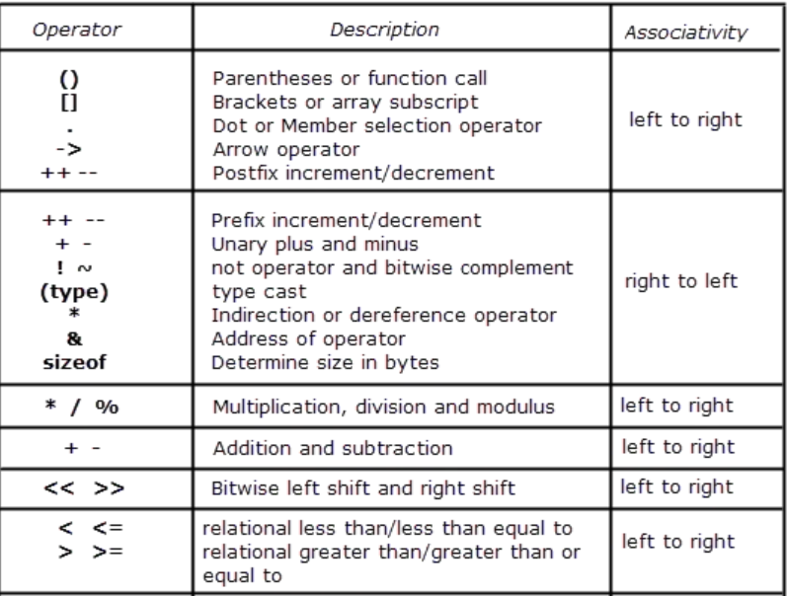

Slide 116
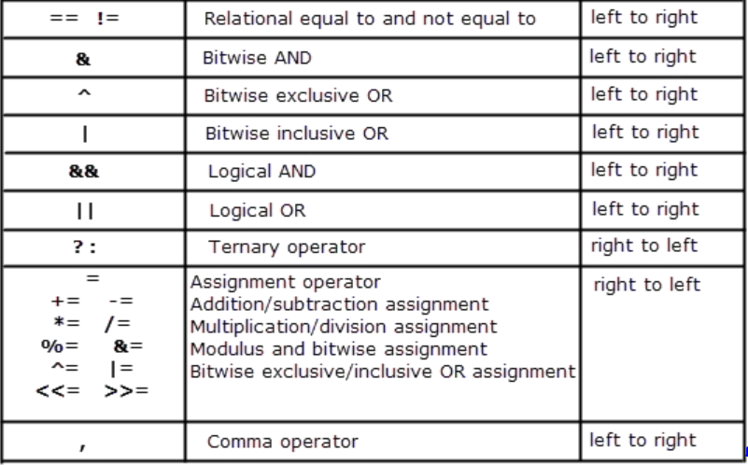

Slide 117
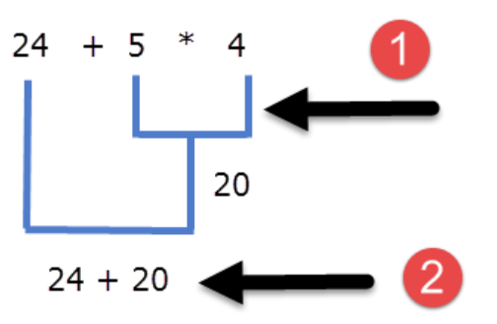
Operators in the top have higher precedence and it decreases as we move towards the bottom.
From the precedence table, we can conclude that the * operator is above the + operator, so the * operator has higher precedence than the + operator,
24 + 5 * 4

Slide 118
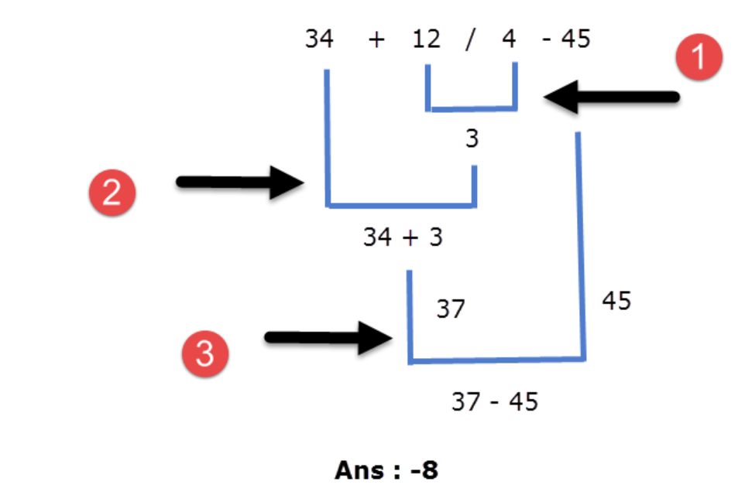
34 + 12/4 – 45

Slide 119
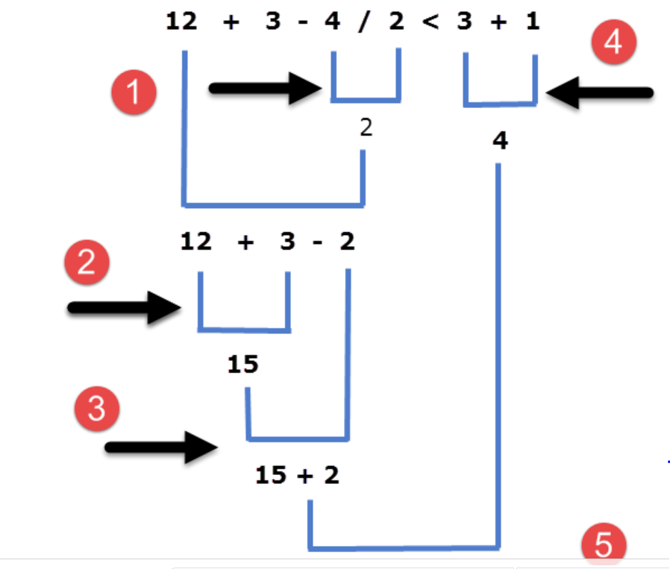
12 + 3 - 4 / 2 < 3 + 1

Slide 120
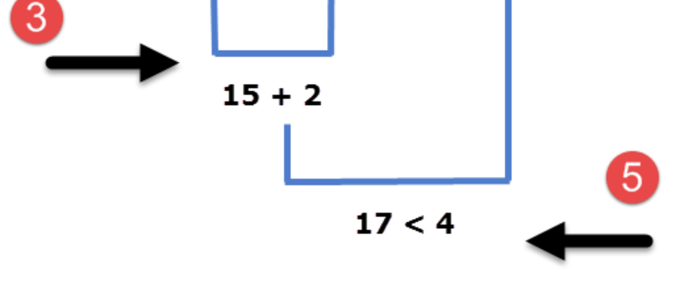

Slide 121
Example:
#include <stdio.h>
int main ()
{
int x, y;
x = 10*20+110/5;
printf ("The Value of x = %d", x);
return 0;
}

Slide 122
Evaluate the arithmetic expression ((a -b / c * d + e) * (f +g)) and display its solution
void main()
{
int a,b,c,d,e,f,g,result;
printf("enter value of a : ");
scanf("%d",& a);
printf("enter value of b : ");
scanf("%d",& b);
printf("enter value of c : ");
scanf("%d",& c);
printf("enter value of d : ");
scanf("%d",& d);
printf("enter value of e : ");
scanf("%d",& e);
printf("enter value of f : ");
scanf("%d",& f);
printf("enter value of g : ");
scanf("%d",& g);
result=((a -(((b / c) * d) + e)) * (f +g));
printf("after evaluation result is :%d ",result);
}

Slide 123
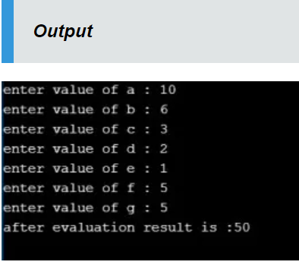

Slide 124
Definition :
Expression evaluation in C is used to determine the order of the operators to calculate the accurate output. Arithmetic, Relational, Logical, and Conditional are expression evaluations in C.
Types of Expression Evaluation in C
In C there are 4 types of expressions evaluations
Arithmetic expressions evaluation
Relational expressions evaluation
Logical expressions evaluation
Conditional expressions evaluation

Slide 125
Arithmetic expression Evaluation
Addition (+), Subtraction(-), Multiplication(*), Division(/), Modulus(%), Increment(++) and Decrement(–) operators are said to “Arithmetic expressions”. These operators work in between operands. like A+B, A-B, A–, A++ etc. While we perform the operation with these operators based on specified precedence order as like below image.
A+B*C/D-E%F

Slide 126
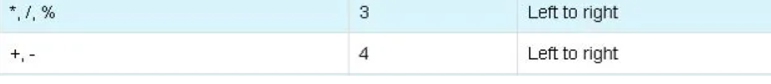

Slide 127
Type Conversion(Type Casting)
Typecasting is a method in C language of converting one data type to another.
There are two types of typecasting:
1.Implicit Type casting :This conversion is done by the compiler. When more than one data type of variables are used in an expression, the compiler converts data types to avoid loss of data.
Also known as ‘automatic type conversion’.
Done by the compiler on its own, without any external trigger from the user.
Generally takes place when in an expression more than one data type is present. In such condition type conversion (type promotion) takes place to avoid loss of data.
All the data types of the variables are upgraded to the data type of the variable with largest data type.

Slide 128
bool -> char -> short int -> int -> unsigned int -> long -> unsigned -> long long -> float -> double -> long double
It is possible for implicit conversions to lose information, signs can be lost (when signed is implicitly converted to unsigned), and overflow can occur (when long long is implicitly converted to float).
Example of Type Implicit Conversion:
#include <stdio.h> int main() { int a = 10; char b = 'S'; float c = 2.88; a = a+b; printf("Implicit conversion from character to integer : %d\n",a); c = c+a; printf("Implicit conversion from integer to float : %f\n",c); return 0; }

Slide 129
Example:
#include <stdio.h>
int main()
{
int a = 10; char b = 'S'; float c = 2.88;
a = a+b;
printf("Implicit conversion from character to integer : %d\n",a);
c = c+a;
printf("Implicit conversion from integer to float : %f\n",c);
return 0;
}
OutPut: Implicit conversion from character to integer : 93
Implicit conversion from integer to float : 95.879997

Slide 130
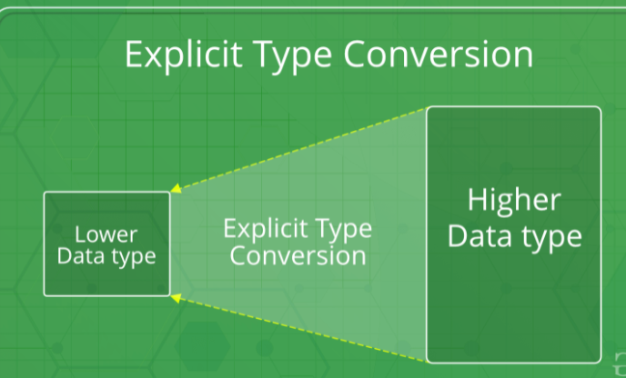
Explicit Type Conversion:
This process is also called type casting and it is user defined. Here the user can type cast the result to make it of a particular data type.

Slide 131
#include<stdio.h>
int main()
{
double x = 1.2;
// Explicit conversion from double to int
int sum = (int)x + 1;
printf("sum = %d", sum);
return 0;
}
Output:
sum = 2

Slide 132
Advantages of Type Conversion
This is done to take advantage of certain features of type hierarchies or type representations.
It helps us to compute expressions containing variables of different data types.

Slide 133
C - Decision Making Structure
Decision making structures require that the programmer specifies one or more conditions to be evaluated or tested by the program, along with a statement or statements to be executed if the condition is determined to be true, and optionally, other statements to be executed if the condition is determined to be false.

Slide 134
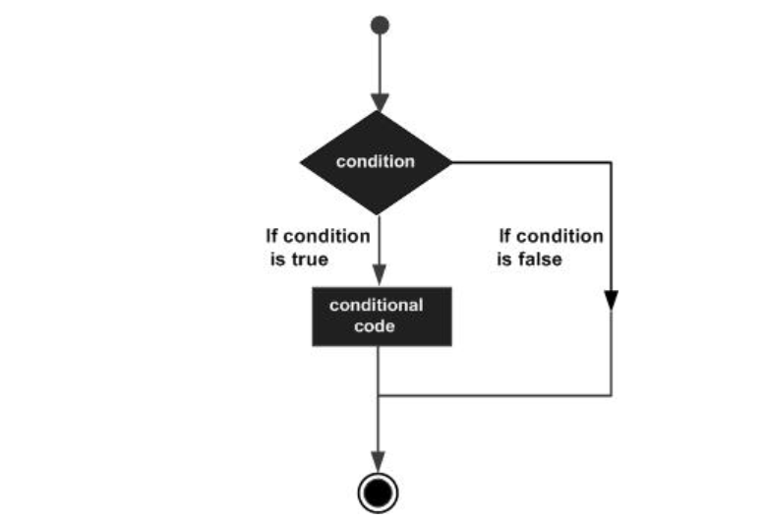
Syntax:

Slide 135
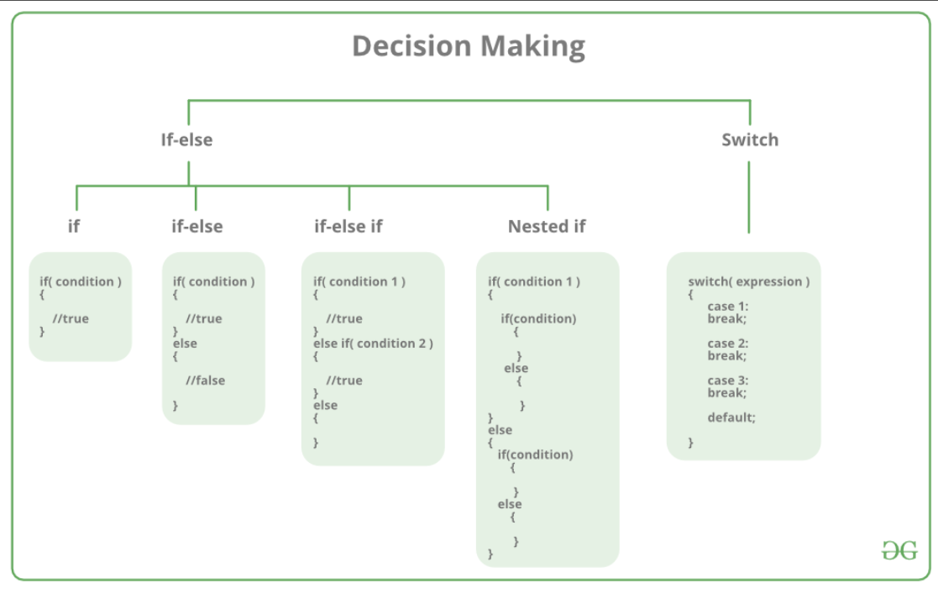

Slide 136
The different types of control statements in C language are:
Decision making statements
  if statement
  switch statement
Iterative statements
  while statement
  do...while statement
  for statement
Jump statements
  break
  continue
  goto

Slide 137
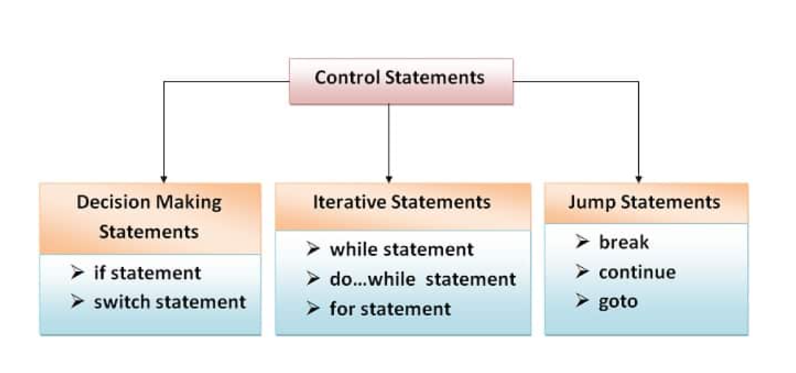

Slide 138
If Statement
An if statement consists of a Boolean expression followed by one or more statements
Syntax:
If (boolean_expression)
{
/* statement(s) will execute if the boolean expression is true */
}

Slide 139
If the Boolean expression evaluates to true, then the block of code inside the 'if' statement will be executed.
If the Boolean expression evaluates to false, then the first set of code after the end of the 'if' statement (after the closing curly brace) will be executed.
C programming language assumes any non-zero and non-null values as true and if it is either zero or null, then it is assumed as false value.

Slide 140
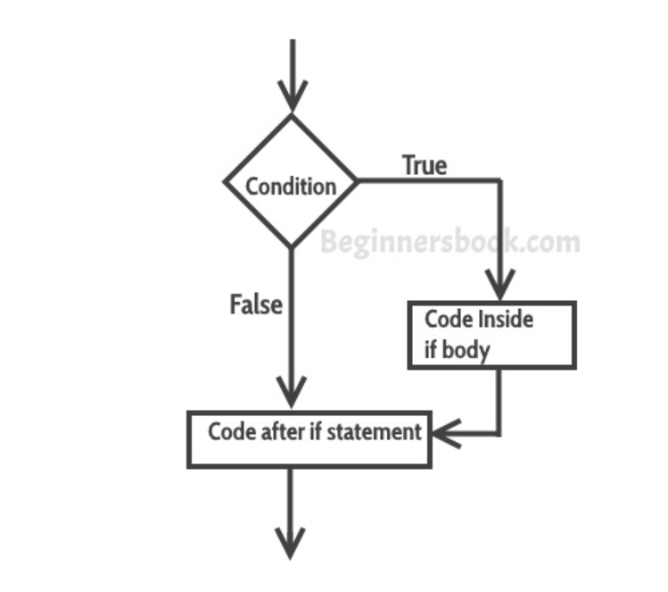

Slide 141
#include <stdio.h>
int main ()
{ /* local variable definition */
int a = 10; /* check the boolean condition using if statement */
if( a < 20 )
{ /* if condition is true then print the following */ printf("a is less than 20\n" );
}
printf("value of a is : %d\n", a);
return 0;
}

Slide 142
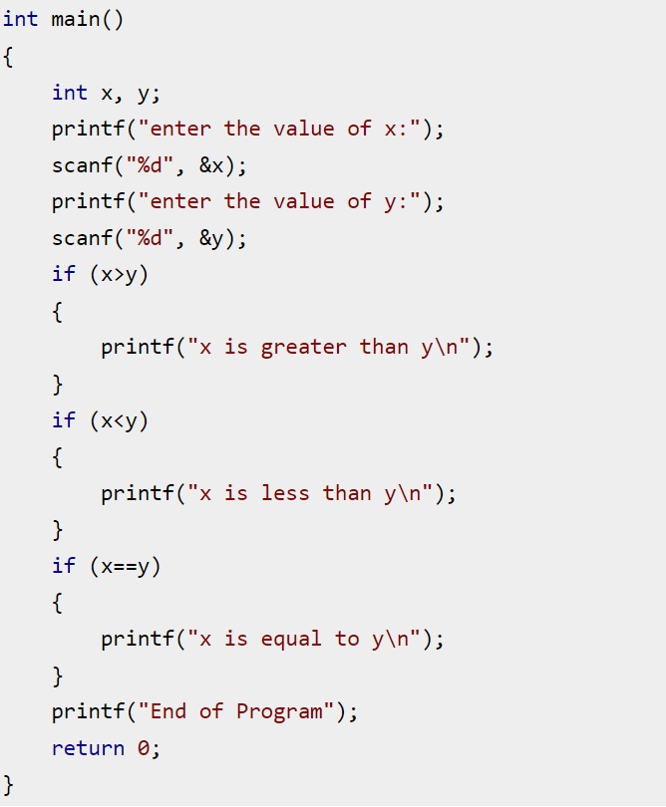
Example on Multiple If statement

Slide 143
If-else Statement
The if-else statement is used to perform two operations for a single condition.
The if-else statement is an extension to the if statement using which, we can perform two different operations, i.e., one is for the correctness of that condition, and the other is for the incorrectness of the condition.
Here, we must notice that if and else block cannot be executed simiulteneously.
Using if-else statement is always preferable since it always invokes an otherwise case with every if condition.

Slide 144
Syntax:
if(expression)
{
//code to be executed if condition is true
}
Else
{
//code to be executed if condition is false
}

Slide 145
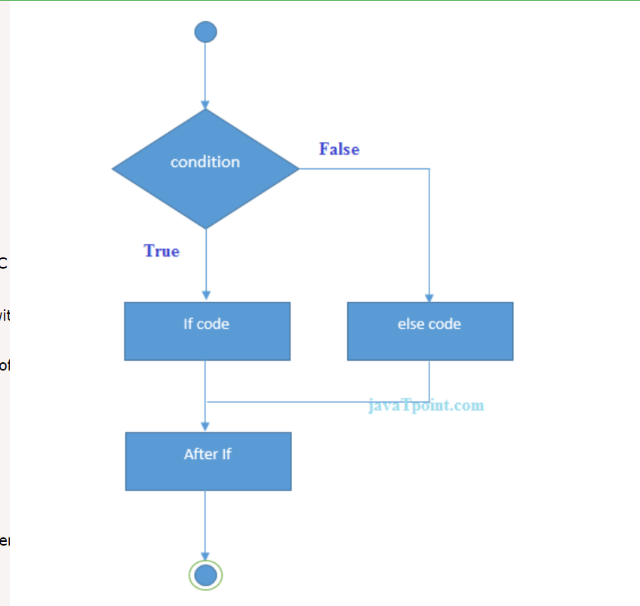
Flow Chart:

Slide 146
Example on if-else: Program to check whether a person is eligible to vote or not.
#include <stdio.h>
int main()
{
int age;
printf("Enter your age?");
scanf("%d",&age);
if(age>=18)
{
printf("You are eligible to vote...");
}
else
{
printf("Sorry ... you can't vote");
}
}

Slide 147
If else-if ladder Statement
The if-else-if ladder statement is an extension to the if-else statement. It is used in the scenario where there are multiple cases to be performed for different conditions.
In if-else-if ladder statement, if a condition is true then the statements defined in the if block will be executed, otherwise if some other condition is true then the statements defined in the else-if block will be executed, at the last if none of the condition is true then the statements defined in the else block will be executed.
There are multiple else-if blocks possible. It is similar to the switch case statement where the default is executed instead of else block if none of the cases is matched.

Slide 148
if(condition1)
{
//code to be executed if condition1 is true
}
else if(condition2)
{
//code to be executed if condition2 is true
}
else if(condition3)
{
//code to be executed if condition3 is true
}
Else
{
//code to be executed if all the conditions are false
}

Slide 149
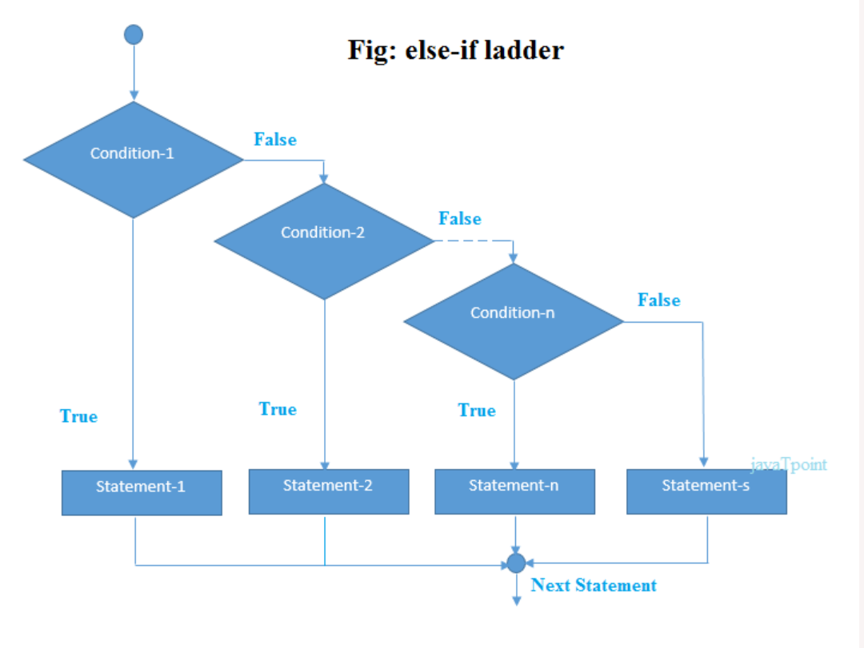

Slide 150
#include<stdio.h>
int main()
{
int number=0;
printf("enter a number:");
scanf("%d",&number);
If (number==10){
printf("number is equals to 10");
}
else if (number==50){
printf("number is equal to 50");
}
else if (number==100){
printf("number is equal to 100");
}
else{
printf("number is not equal to 10, 50 or 100");
}
return 0;
}

Slide 151
Nested If
Nested If in C Programming is placing If Statement inside another IF Statement.
Nested If in C is helpful if you want to check the condition inside a condtion.
If Else Statement prints different statements based on the expression result (TRUE, FALSE).
Sometimes we have to check even further when the condition is TRUE. In these situations, we can use these C Nested IF statements, but be careful while using it.

Slide 152
Syntax
if( boolean_expression 1)
{
/* Executes when the boolean expression 1 is true */
if(boolean_expression 2)
{
/* Executes when the boolean expression 2 is true */
}
}

Slide 153
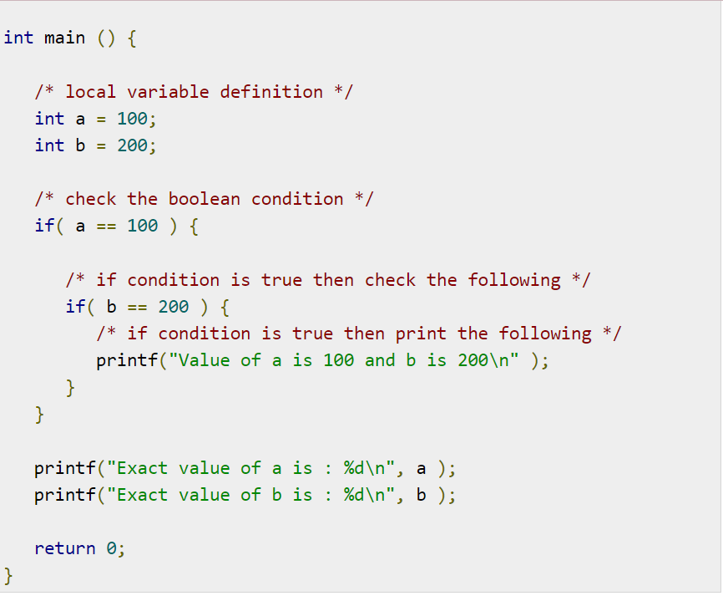
Example:

Slide 154
Switch:
A switch statement allows a variable to be tested for equality against a list of values. Each value is called a case, and the variable being switched on is checked for each switch case.

Slide 155
Functioning of switch case statement
First, the integer expression specified in the switch statement is evaluated.
This value is then matched one by one with the constant values given in the different cases.
If a match is found, then all the statements specified in that case are executed along with the all the cases present after that case including the default statement.
No two cases can have similar values. If the matched case contains a break statement, then all the cases present after that will be skipped, and the control comes out of the switch. Otherwise, all the cases following the matched case will be executed.

Slide 156
Syntax:
Switch (expression)
{
case Value-1 :
Block-1;
break;
case Value-2 :
Block-2;
break;
default :
Default-block
break;
}
Statement-x;

Slide 157
The following rules apply to a switch statement −
The expression used in a switch statement must have an integral or enumerated type, or be of a class type in which the class has a single conversion function to an integral or enumerated type.
You can have any number of case statements within a switch. Each case is followed by the value to be compared to and a colon.
The constant-expression for a case must be the same data type as the variable in the switch, and it must be a constant or a literal.
When the variable being switched on is equal to a case, the statements following that case will execute until a break statement is reached.
When a break statement is reached, the switch terminates, and the flow of control jumps to the next line following the switch statement.
Not every case needs to contain a break. If no break appears, the flow of control will fall through to subsequent cases until a break is reached.
A switch statement can have an optional default case, which must appear at the end of the switch. The default case can be used for performing a task when none of the cases is true. No break is needed in the default case.

Slide 158
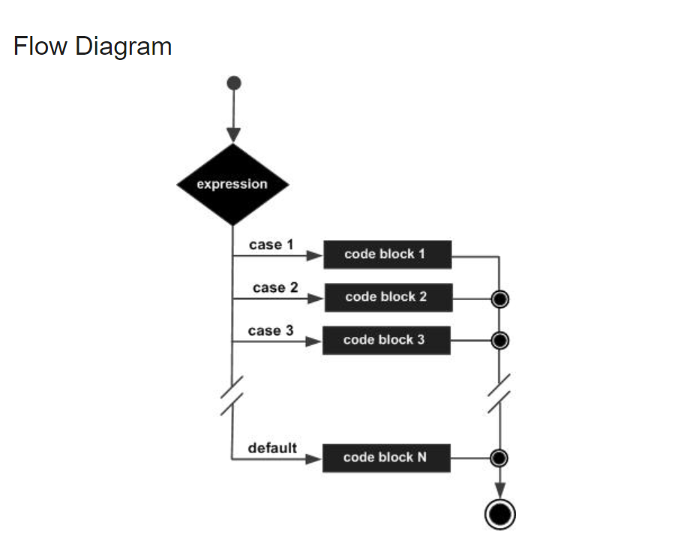

Slide 159
Example:
int main ()
{ /* local variable definition */
char grade = 'B';
switch(grade)
{
case 'A' : printf("Excellent!\n" );
break;
case 'B' :
case 'C' :
printf("Well done\n" );
break;
case 'D' : printf("You passed\n" );
break;
case 'F' : printf("Better try again\n" );
break;
default : printf("Invalid grade\n" );
}
printf ("Your grade is %c\n", grade );
return 0;
}
B
Out Put:
Well done
Your grade is B

Slide 160
Iteration :
Iteration is the process where a set of instructions or statements is executed repeatedly for a specified number of time or until a condition is met. These statements also alter the control flow of the program and thus can also be classified as control statements in C Programming Language.

Slide 161
C Iteration Statements
Iteration statements create loops in the program. In other words, it repeats the set of statements until the condition for termination is met. Iteration statements in C are for, while and do-while.
jump Statement makes the control jump to another section of the program unconditionally when encountered. It is usually used to terminate the loop or switch-case instantly. It is also used to escape the execution of a section of the program.

Slide 162
Iteration:
Iteration is the process where a set of instructions or statements is executed repeatedly for a specified number of time or until a condition is met. These statements also alter the control flow of the program and thus can also be classified as control statements in C Programming Language.

Slide 163
while(test_expression)
{
statements;
while(test_expression)
{
statements;
}
}

Slide 164
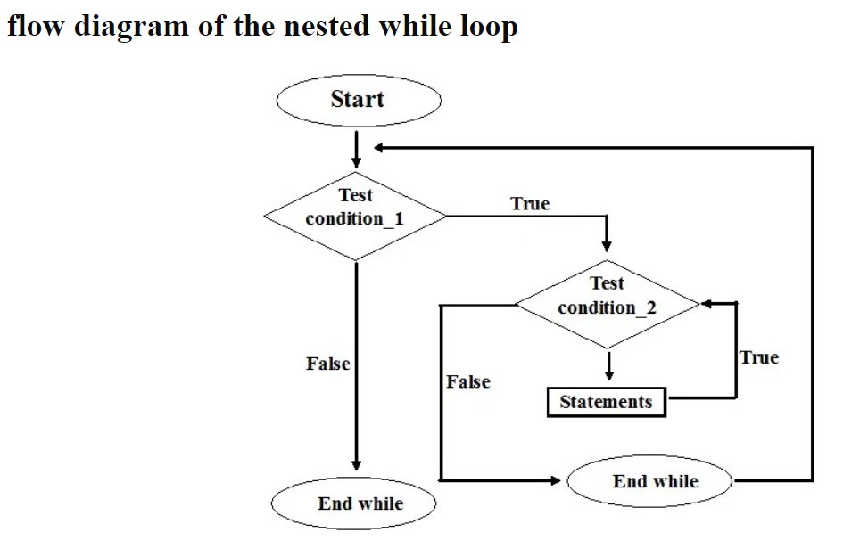

Slide 165
Example:
int main()
{
int i=1;
while(i<=3){
printf("%d :inner loop is executed only once\n",i);
int j=1;
while(j<=4){
printf("%d :Outer loop is executed until to completion\n",j);
j++;
}
i++;
}
getch();
return 0;
}

Slide 166
Example on Multiplication table:
int main()
{
printf("Multiplication table\n\n");
int i=1,j;
while(i<=10){
j=1;
while(j<=10){
printf("%d\t",j*i);
j++;
}
printf("\n");
i++;
}
getch();
return 0;
}

Slide 167
Do While:
#include<stdio.h>
int main(){
int i=1;
do{
printf("%d \n",i);
i++;
}while(i<=10);
return 0;
}

Slide 168
Example2
#include<stdio.h>
int main(){
int i=1,number=0;
printf("Enter a number: ");
scanf("%d",&number);
do{
printf("%d \n",(number*i));
i++;
}while(i<=10);
return 0;
}

Slide 169
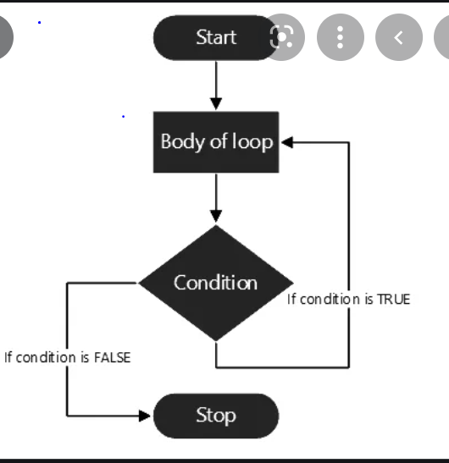
Flow Diagram for Do While :

Slide 170
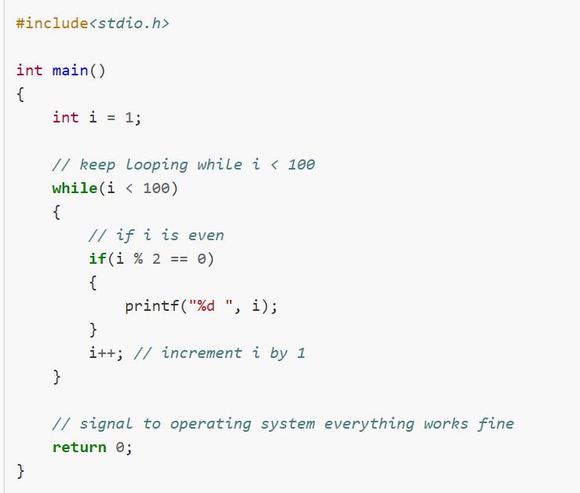

Slide 171
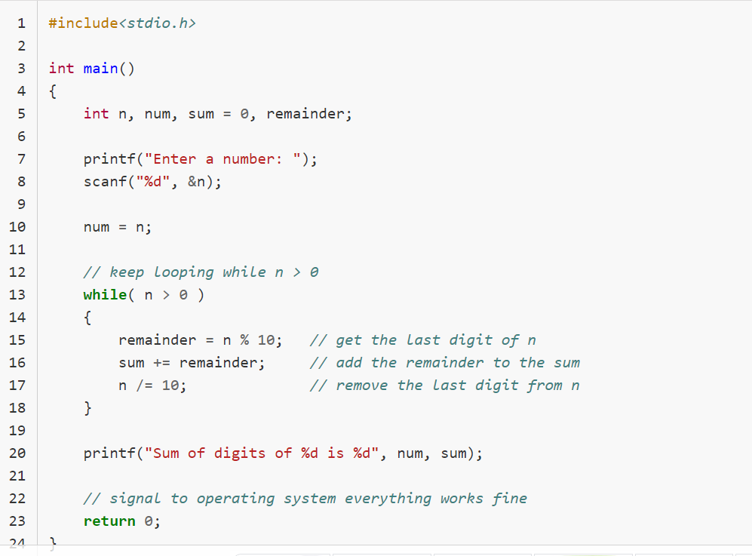

Slide 172
Output:
Enter a number: 222 Sum of digits of 222 is 6

Slide 173
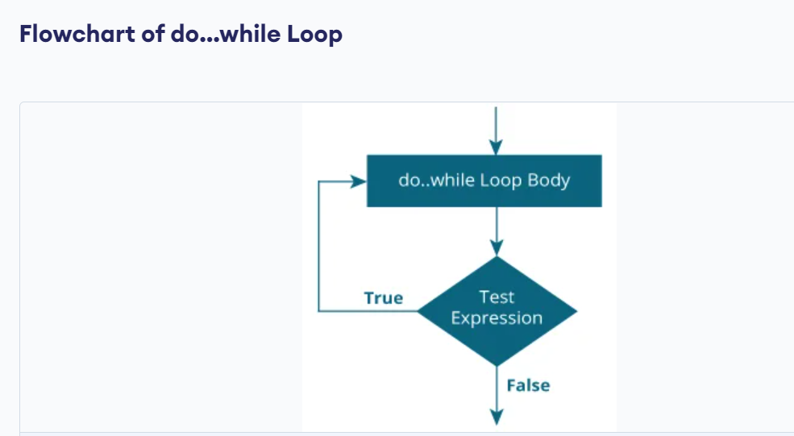

Slide 174
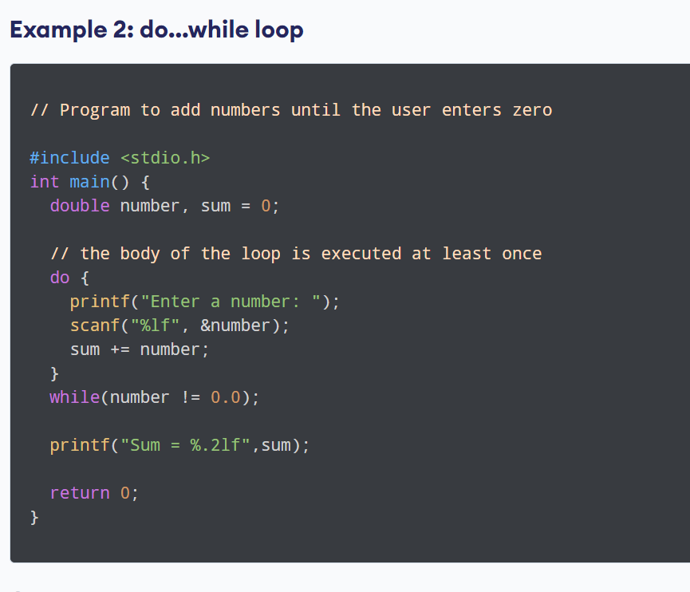

Slide 175
#include <stdio.h>
int main()
{
int j=0;
do
{
printf("Value of variable j is: %d\n", j);
j++;
}while (j<=3);
return 0;
}

Slide 176
OutPut:
Value of variable j is: 0
Value of variable j is: 1
Value of variable j is: 2
Value of variable j is: 3

Slide 177
#include <stdio.h>
int main()
{
int i=0;
do
{
printf("while vs do-while\n");
}while(i==1);
printf("Out of loop");
}Output:
while vs do-while
Out of loop

Slide 178
Print numbers 0-9
#include <stdio.h>
int main()
{
int j=0;
do
{
if (j==7)
{
j++; continue;
}
printf("%d ", j);
j++;
}while(j<10);
return 0;
}

Slide 179
Out-Put:
0 1 2 3 4 5 6 8 9

Slide 180
Print Hello word
int main()
{
int i = 2;
do {
printf("Hello World\n");
i++;
}
while (i < 1);
return 0;
}

Slide 181
Out-Put:
Hello World

Slide 182
Benefits of Do while loop :
do / While loop is often used in situations where the activity to be performed must happen at least once before checking the exit condition in the while loop.
In while loop, if the condition is not satisfied even once, the loop will not be executed.
Whereas in do-while loop, even if the condition is not true, the loop is executed atleast once.

Slide 183
For Loop:
for loop is used to execute a set of statements repeatedly until a particular condition is satisfied. We can say it is an open ended loop..
In for loop we have exactly two semicolons, one after initialization and second after the condition. In this loop we can have more than one initialization or increment/decrement, separated using comma operator. But it can have only one condition.

Slide 184
The for loop is executed as follows:
It first evaluates the initialization code.
Then it checks the condition expression.
If it is true, it executes the for-loop body.
Then it evaluate the increment/decrement condition and again follows from step 2.
When the condition expression becomes false, it exits the loop.

Slide 185
Syntax:
for (initialization Statement; test Expression; updateStatement)
{
// statements inside the body of loop ;
}

Slide 186
How for loop works?
The initialization statement is executed only once.
Then, the test expression is evaluated. If the test expression is evaluated to false, the for loop is terminated.
However, if the test expression is evaluated to true, statements inside the body of the for loop are executed, and the update expression is updated.
Again the test expression is evaluated.
This process goes on until the test expression is false. When the test expression is false, the loop terminates.

Slide 187
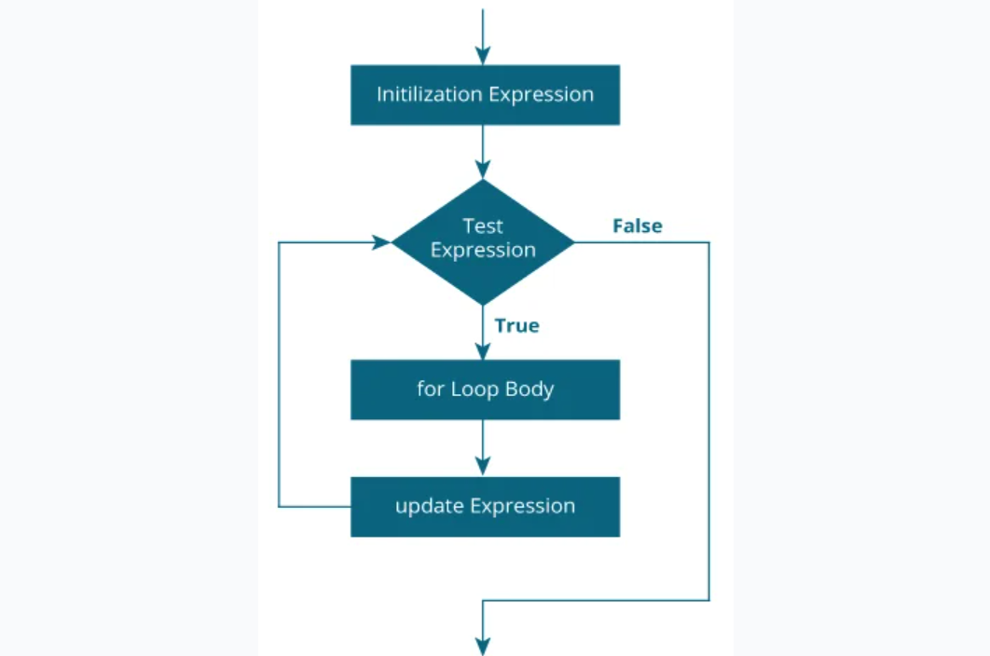
Flow Diagram:

Slide 188
// Print numbers from 1 to 10
#include <stdio.h>
int main()
{
int i;
for (i = 1; i < 11; i++)
{
printf("%d ", i);
}
return 0;
}

Slide 189
goto Statement:
The goto statement is a jump statement which is sometimes also referred to as unconditional jump statement. The goto statement can be used to jump from anywhere to anywhere within a function.
When a goto statement is encountered in a C program, the control jumps directly to the label mentioned in the goto stateemnt

Slide 190
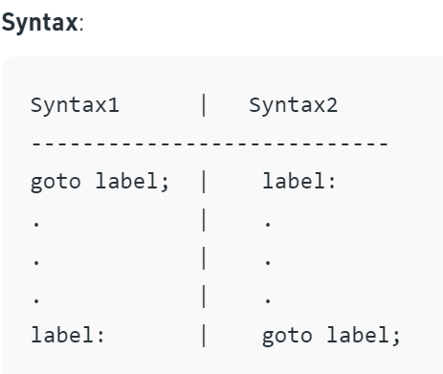

Slide 191
Note:
The goto statement is rarely used because it makes program confusing, less readable and complex. Also, when this is used, the control of the program won’t be easy to trace, hence it makes testing and debugging difficult.

Slide 192
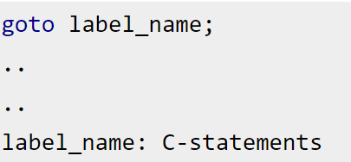

Slide 193


Slide 194
#include <stdio.h>
int main()
{
int sum=0;
for(int i = 0; i<=10; i++)
{
sum = sum+i;
if(i==5)
{
goto addition;
}
}
addition:
printf("%d", sum);
return 0;
}
output: 15

Slide 195


Slide 196
1. Enter a number: 3
2. Enter a number: 4.3
3. Enter a number: 9.3
4. Enter a number: -2.9
Sum = 16.60
Average = 5.53

